Slide 1
John Wayne Airport Fly Friendly Program
General Aviation Jet Operators
John Wayne Airport
Access and Noise Office

Slide 2
John Wayne Airport’s Fly Friendly program helps care for our surrounding communities by providing education to General Aviation jet operators and celebrating their voluntary efforts to reduce measurable noise and offset impacts on the environment through an annual awards process.

Slide 3
Presentation Goals
This presentation will help you to:
Better understand how the hours of operation and maximum permitted noise levels associated with General Aviation (GA) operations are regulated
Understand Fly Friendly’s (FF) participation and scoring criteria
Access resources that will empower you to help promote awareness of this new initiative

Slide 4
Introduction to Noise Abatement at JWA
JWA is one of the most noise sensitive airports in the United States, and is located in the center of Orange County, California with residential areas in close proximity
To mitigate potential noise impacts from aircraft operations and to enhance compatibility with surrounding communities, the Airport maintains some of the most stringent noise regulations in the country
The General Aviation Noise Ordinance (GANO) has been adopted by the County of Orange to regulate the hours of operation and the maximum permitted noise levels associated with general aviation operations
Compliance with the GANO is mandatory unless deviations are made necessary by Air Traffic Control instructions, a medical or in-flight emergency, or other safety considerations
Fly Friendly scoring does not overrule or mitigate noise violations issued under the GANO

Slide 5
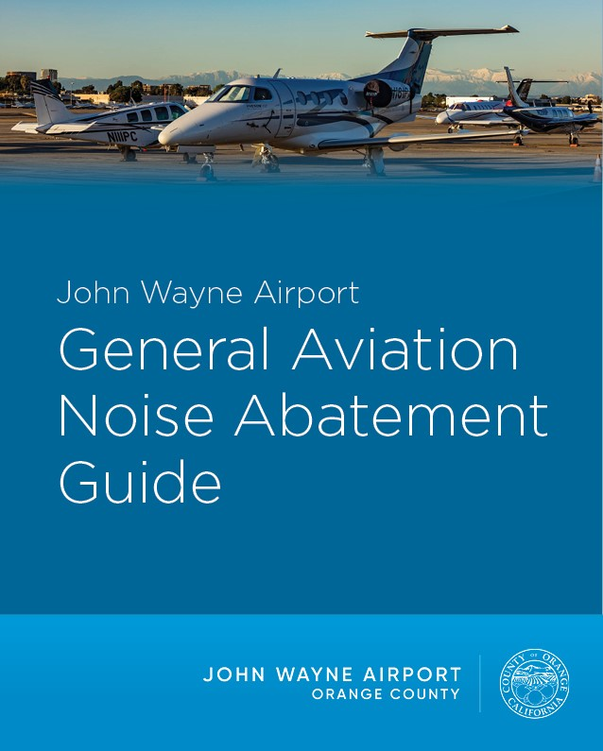
Noise Abatement Resources
To access a list of frequently asked questions about noise abatement at JWA, please visit https://www.ocair.com/about/administration/access-noise/access-noise-faqs/
JWA’s GA Noise Abatement Guide is available to view and download at www.ocair.com/business/general-aviation/pilot-information/noise-abatement/
To reach the Access & Noise Office with questions, please call (949) 252-5185

Slide 6
Fly Friendly Scoring Elements
Scoring is based on the following four elements:
(Detailed scoring methodology is available at www.ocair.com/FlyFriendly)
Quietest Departures: Awards points to operators based on the amount of measurable noise on departure over the full calendar year, as verified by the Airport’s noise monitoring system data
Ways to achieve reduced noise include, but are not limited to:
Technical modifications to existing aircraft and acquiring/utilizing newer, quieter equipment
Operational modifications such as choosing to fly in accordance with the quietest GA jet departure procedure for JWA: the National Business Aviation Association’s (NBAA) Standard Noise Abatement Departure Procedure (NADP)
If pilots voluntarily fly this procedure, community members under and near the flight path between JWA and the shoreline will experience less noise

Slide 7
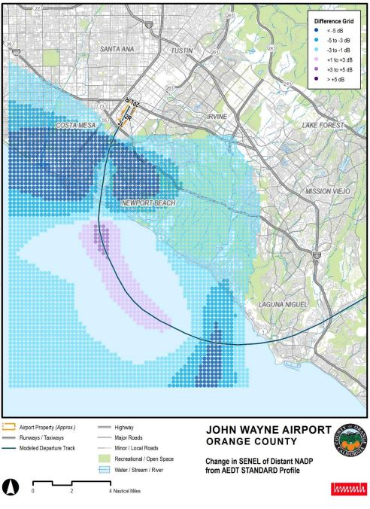
Quietest Departures (cont.)
Instructions for Pilots*
Climb at maximum practical rate not to exceed V2+20 KIAS (maximum pitch attitude 20 degrees) to 1,000 feet AAE in takeoff configuration at takeoff thrust.
At 1,000 feet AAE, begin acceleration to final segment speed (VFS or VFTO) and retract flaps. Reduce to a quiet climb power setting while maintaining a rate of climb necessary to comply with IFR departure procedure, otherwise a maximum of 1,000 FPM at an airspeed not to exceed 190 KIAS, until reaching 3,000 feet AAE. If ATC requires level off prior to reaching NADP termination height, power must be reduced so as not to exceed 190 KIAS.
Above 3,000 feet AAE resume normal climb schedule with gradual application of climb power.
Ensure compliance with applicable IFR climb and airspeed requirements at all times.
*Noise abatement procedures should only be used when
consistent with the safe operation of aircraft

Slide 8
Nighttime Noise Reduction
GA aircraft can operate at JWA 24 hours a day, as long as they comply with applicable noise limits. This component of the program awards points to GA jet operators who voluntarily reduce their number of flights, when safely possible, during the nighttime/early-morning hours of:
Departures: 10 p.m. to 7 a.m. Monday through Saturday and 8 a.m. Sunday
Arrivals: 11 p.m. to 7 a.m. Monday through Saturday and 8 a.m. Sunday

Slide 9
Environmental Stewardship & Sustainability
Awards bonus points to operators who contribute up to $4,500 per calendar year to support:
The production of native plants for use in ecological restoration and habitat enhancement projects in canyon areas impacted by wildfires through the Irvine Ranch Conservancy at http://www.irconservancy.org/donate.html; or
The restoration of native wetland habitats in the Newport Bay Ecological Reserve and Nature Preserve through the Newport Bay Conservancy at https://newportbay.org/home/transactions/donate/
Keeping these beautiful, biologically-diverse ecosystems healthy helps provide all Orange County residents with cleaner air, water and abundant recreational opportunities while offsetting some pollution impacts from aircraft
Learn more at www.ocair.com/FlyFriendly

Slide 10
Most Engaging
Awards *points to GA jet operators who voluntarily implement outreach and education such as: noise abatement training; distribution of Fly Friendly program toolkit materials; and/or attendance at any of the following:
JWA’s Quarterly Noise Meetings: https://www.ocair.com/about/administration/access-noise/ (open to the public)
JWA Fly Friendly Working Group meetings: by invitation only; email FlyFriendly@ocair.com to learn more
City of Newport Beach’s Aviation Committee Meetings: https://www.newportbeachca.gov/government/data-hub/agendas-minutes/aviation-committee
Any Orange County community meeting focused on aviation impacts
*The required submission form for this category is available at www.ocair.com/FlyFriendly

Slide 11
Fly Friendly Toolkit
The FF Toolkit is available at www.ocair.com/FlyFriendly, and contains promotional resources like:
A pre-written newsletter and blog article as well as social media posts tailored for Facebook, Twitter and Instagram
FF brochure and Pilot Quick Card

Slide 12
Thank You!
Thank you for helping John Wayne Airport spread the word about the FF program! Questions? Please email FlyFriendly@ocair.com or visit www.ocair.com/FlyFriendly for more information.

